Slide 1
Convolutional Neural Network
Phong Nguyen
Kien Le

Slide 2
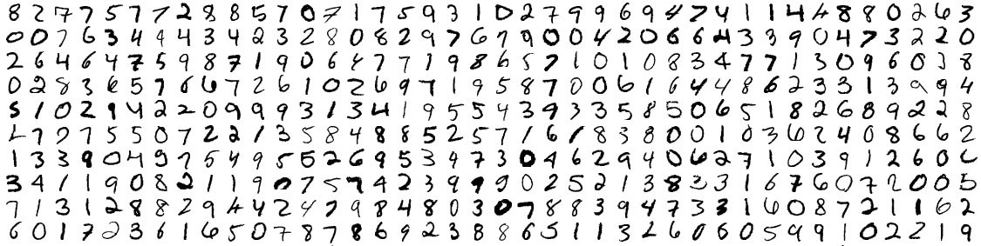
Is Deep Neural Network a magic?
We have learned about the basic of Deep Neural Network in the previous lectures.
They are really magical, right?
Let’s use them again to train a model to recognize hand-written letters (MNIST dataset)

Slide 3
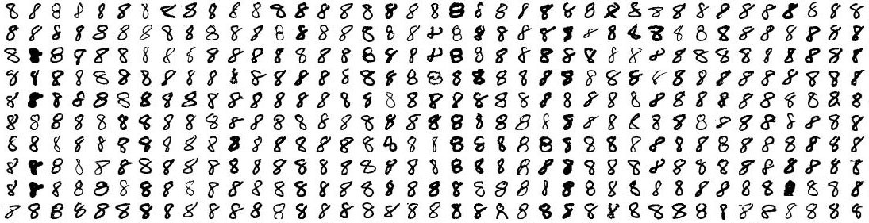
MNIST Dataset
MNIST provides 60,000 images of handwritten digits, each as an 18x18 image.
Let’s just say we need to recognize a digit is “8” or not.

Slide 4

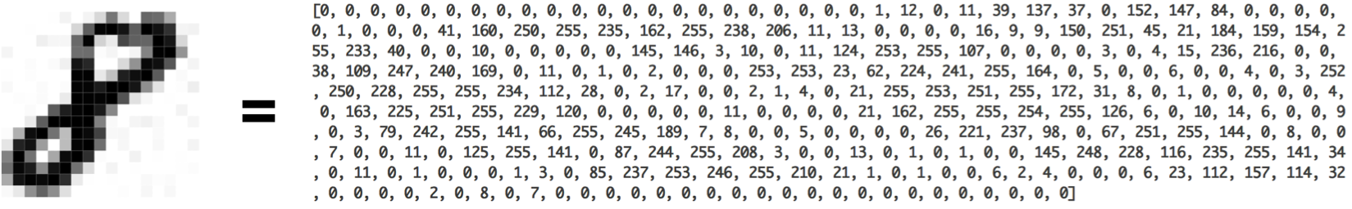
Just a simple classification problem
You would think the power of ML can do it very well?
Let’s apply the DNN we have learned before.
This is basically the input of the DNN.

Slide 5
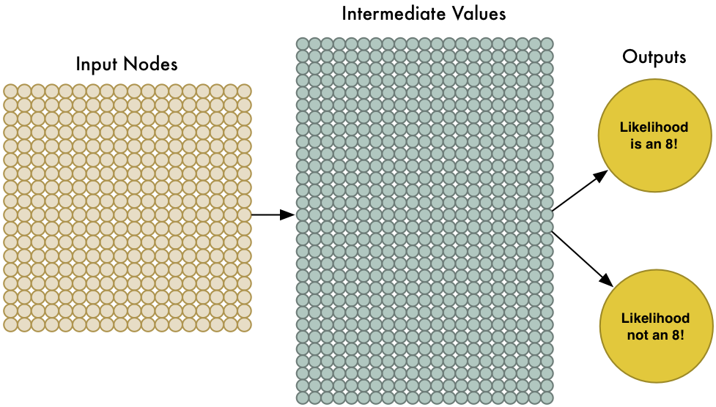
The model we have learned so far

Slide 6
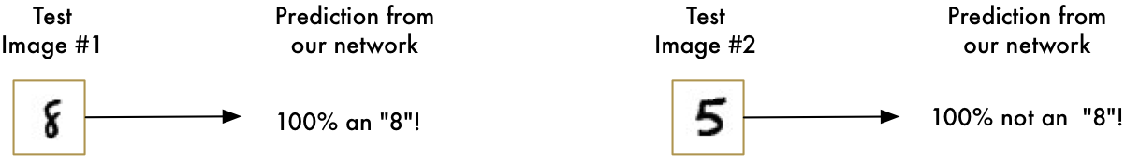
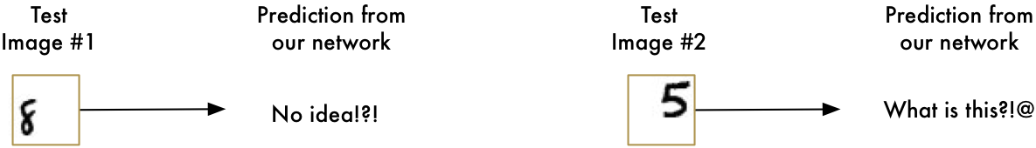
Too easy for DNN???
Good news!
But now, the really bad news!

Slide 7
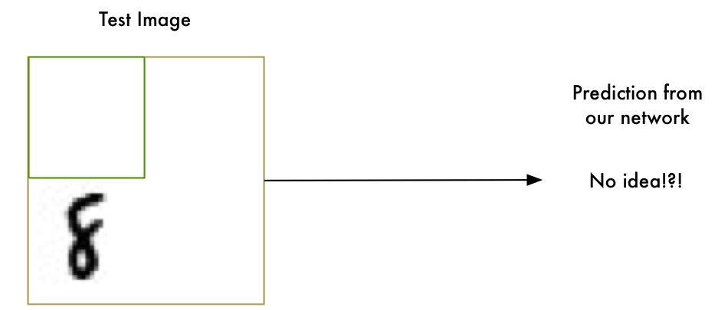
Call for ideas!!!!
Brute force is the king. But that’s not the point we learn ML.

Slide 8
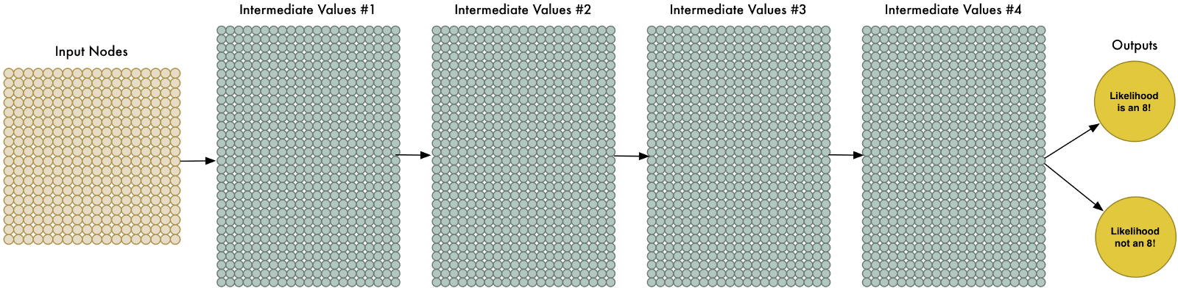
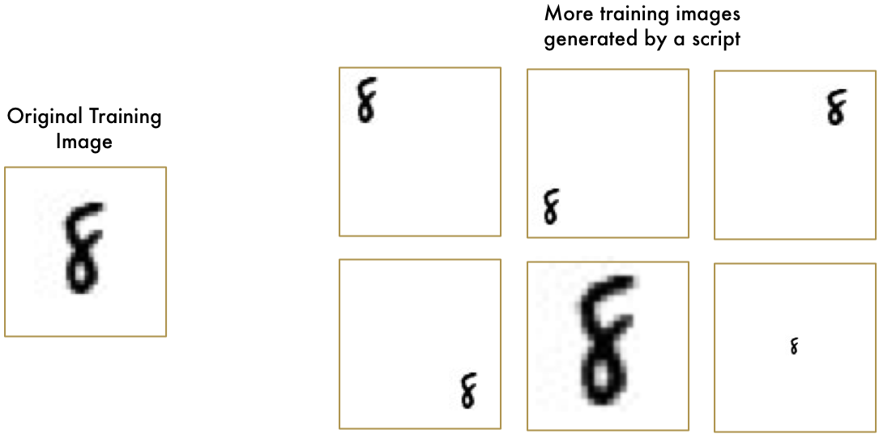
Call for ideas!!!!
More ML way, more data for training, deeper network.

Slide 9
But does it make sense?
First, It doesn’t make sense to train a network to recognize an “8” at the top of a picture separately from training it to recognize an “8” at the bottom of a picture as if those were two totally different objects.
And what about different way to write number “8”? It’s not ML anymore if we need to cover for all such situations.

Slide 10
And magic does exist!
And the elegant solutions for such situation is: CONVOLUTION.
Anything in this world has a hierarchy or conceptual structure.
For example: Human
Body
Hands
Fingers
Foot
Toes
Torso
Head
Eyes
Noses
Ears

Slide 11
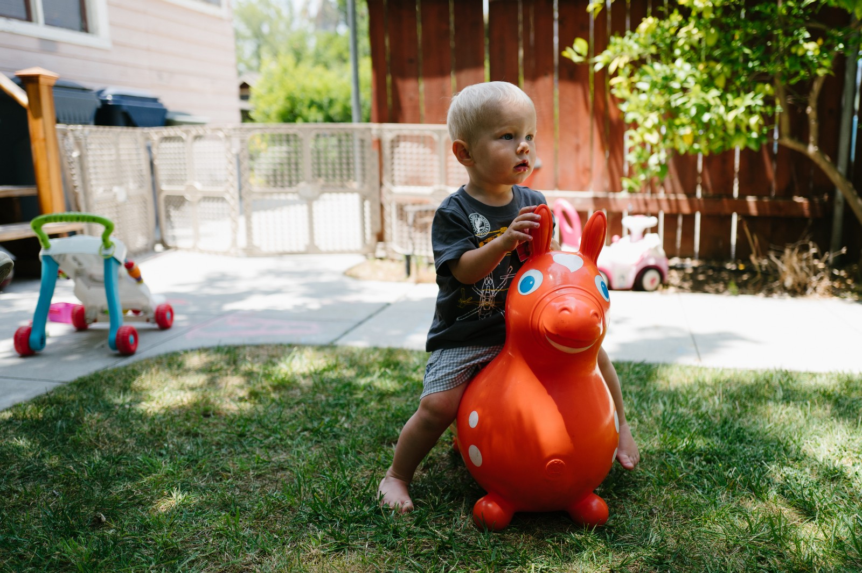
Let’s consider this picture

Slide 12
What your brain sees?
As a human, you instantly recognize the hierarchy in this picture:
The ground is covered in grass and concrete
There is a child
The child is sitting on a bouncy horse
The bouncy horse is on top of the grass
More importantly, we recognize the child no matter where the background is, without “re-learning”.
But our DNN can’t do this right now.

Slide 13
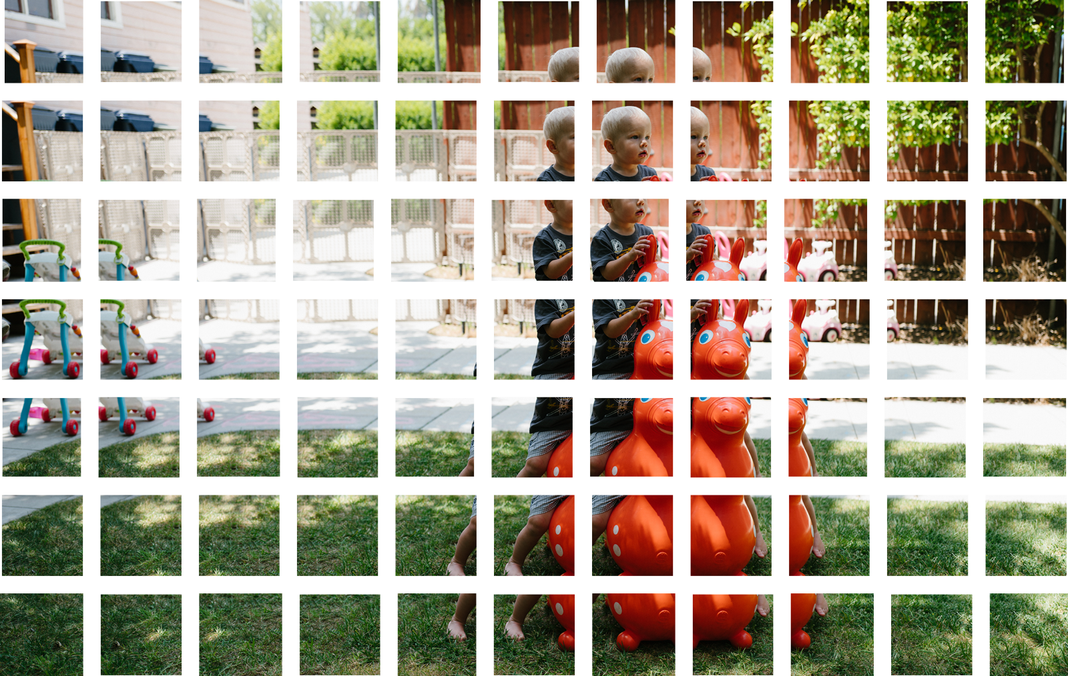
How Convolution Works
Step 1: Break the image into overlapping images tiles
Notes:
Similar to our sliding window search above, let’s pass a sliding window over the entire original image and save each result as a separate, tiny picture tile.
By doing this, we turned our original image into 77 equally-sized tiny image tiles.

Slide 14
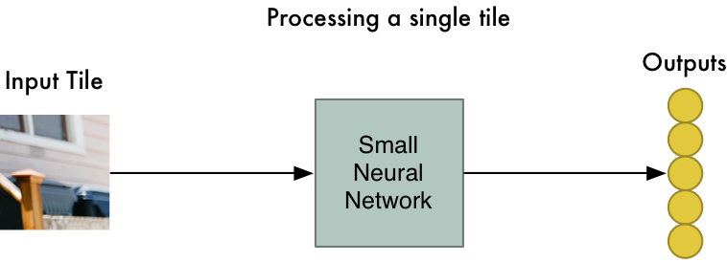
How Convolution Works
Step 2: Feed each image tile into a small neural network
Notes:
Earlier, we fed a single image into a neural network to see if it was an “8”. We’ll do the exact same thing here, but we’ll do it for each individual image tile:
However, there’s one big twist: We’ll keep the same neural network weights for every single tile in the same original image. In other words, we are treating every image tile equally. If something interesting appears in any given tile, we’ll mark that tile as interesting.

Slide 15
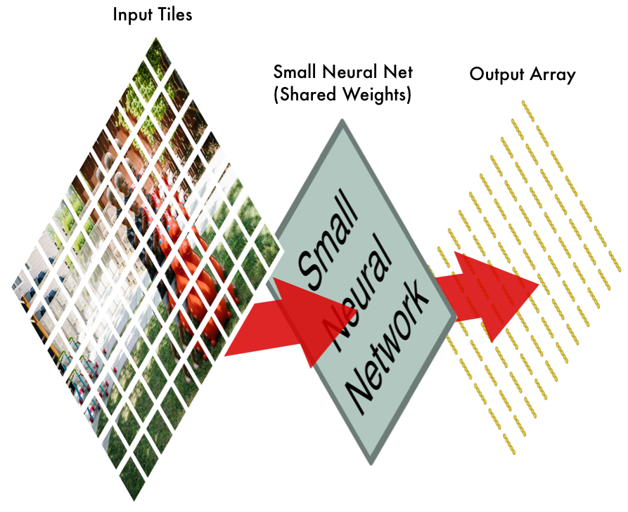
How Convolution Works
Step 3: Save the results from each tile into a new array
Notes:
We don’t want to lose track of the arrangement of the original tiles. So we save the result from processing each tile into a grid in the same arrangement as the original image. It looks like this:
In other words, we’ve started with a large image and we ended with a slightly smaller array that records which sections of our original image were the most interesting.

Slide 16
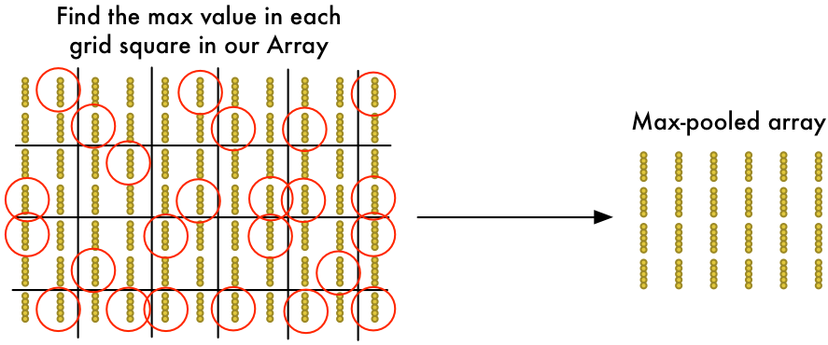
How Convolution Works
Step 4: Downsampling
Notes:
The result of Step 3 was an array that maps out which parts of the original image are the most interesting. But that array is still pretty big:
To reduce the size of the array, we downsample it using an algorithm called max pooling. It sounds fancy, but it isn’t at all!
We’ll just look at each 2x2 square of the array and keep the biggest number:
The idea here is that if we found something interesting in any of the four input tiles that makes up each 2x2 grid square, we’ll just keep the most interesting bit. This reduces the size of our array while keeping the most important bits.

Slide 17
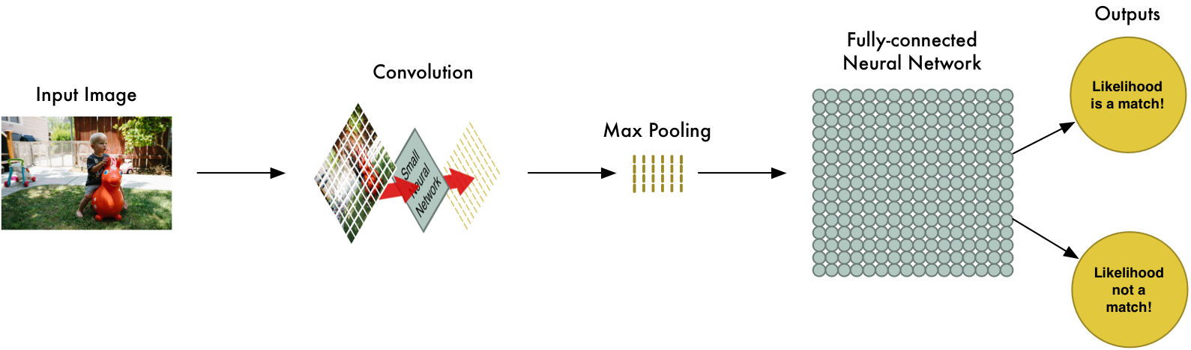
How Convolution Works
Step 5: Make a prediction
Notes:
So far, we’ve reduced a giant image down into a fairly small array.
Guess what? That array is just a bunch of numbers, so we can use that small array as input into another neural network. This final neural network will decide if the image is or isn’t a match. To differentiate it from the convolution step, we call it a “fully connected” network.
So from start to finish, our whole five-step pipeline looks like this:

Slide 18
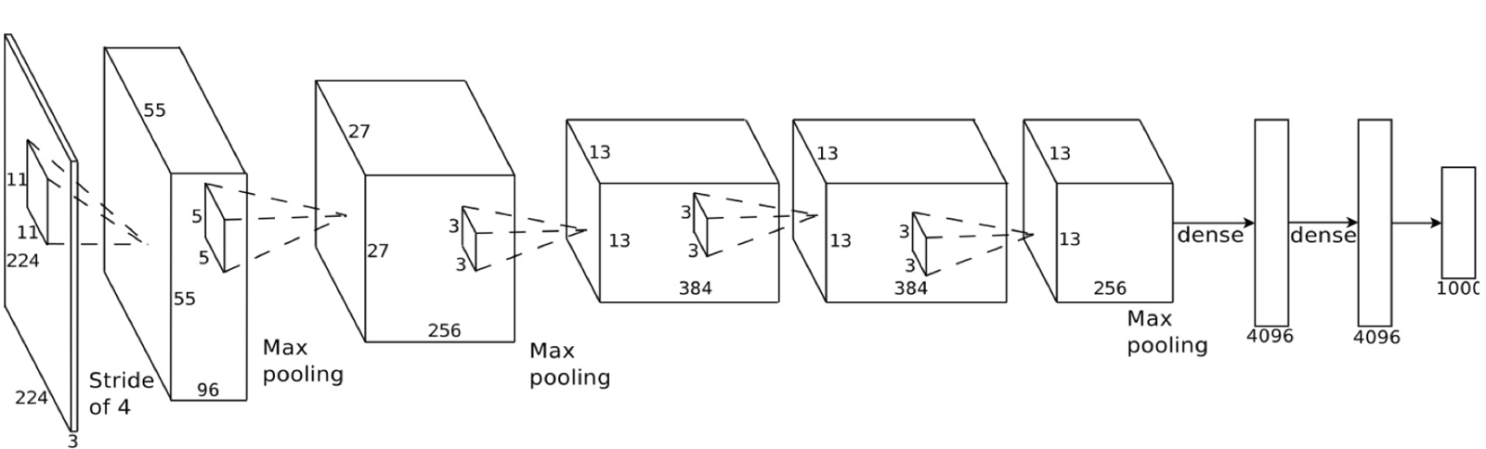
A realistic Convolutional Neural Network
Notes:
In this case, they start a 224 x 224 pixel image, apply convolution and max pooling twice, apply convolution 3 more times, apply max pooling and then have two fully-connected layers. The end result is that the image is classified into one of 1000 categories!

Slide 19
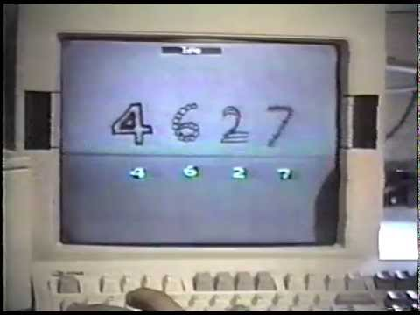
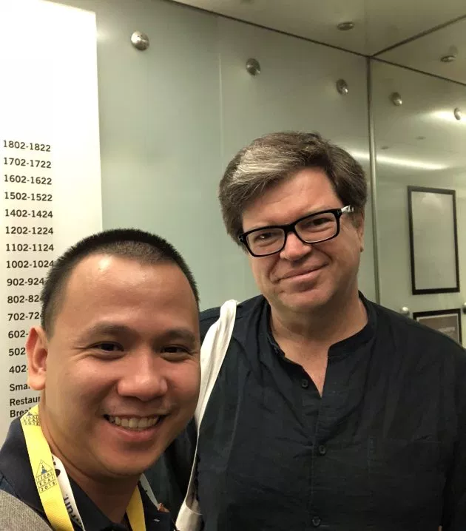
I’m sorry, but time for history!
CNNs was popularized mostly thanks to Yann LeCun, now the Director of AI Research at Facebook.
In early 1990s, LeCun worked at Bell Labs, one of the most pretigous research labs in the world at the time.
Check out this video demo in 1993. Again, 1993.
https://www.youtube.com/watch?v=FwFduRA_L6Q

Slide 20
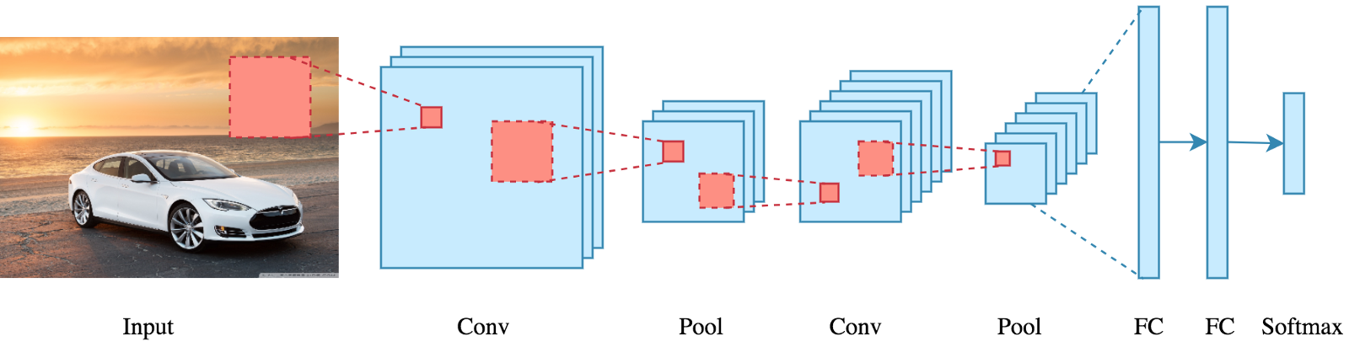
Let’s recap

Slide 21
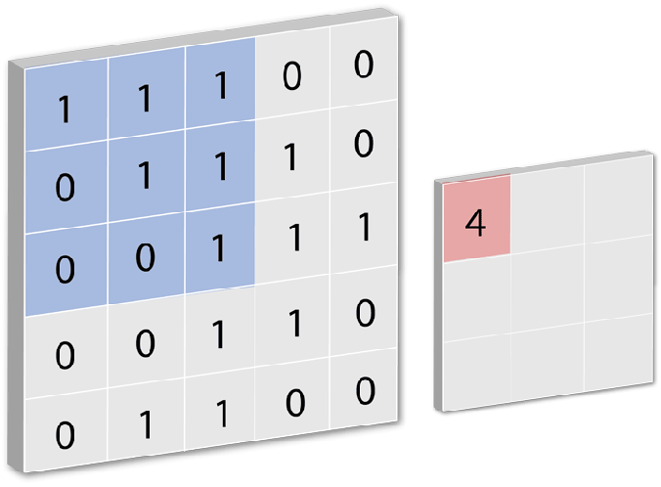
Convolution Layer
Beware of the size of the “filters” or “kernels”
The smaller matrix is called “Feature Map”
Size of feature map is controlled by “depth” (the number of filters used), and “stride” (the number of pixels slid over)
ReLu activation function.

Slide 22
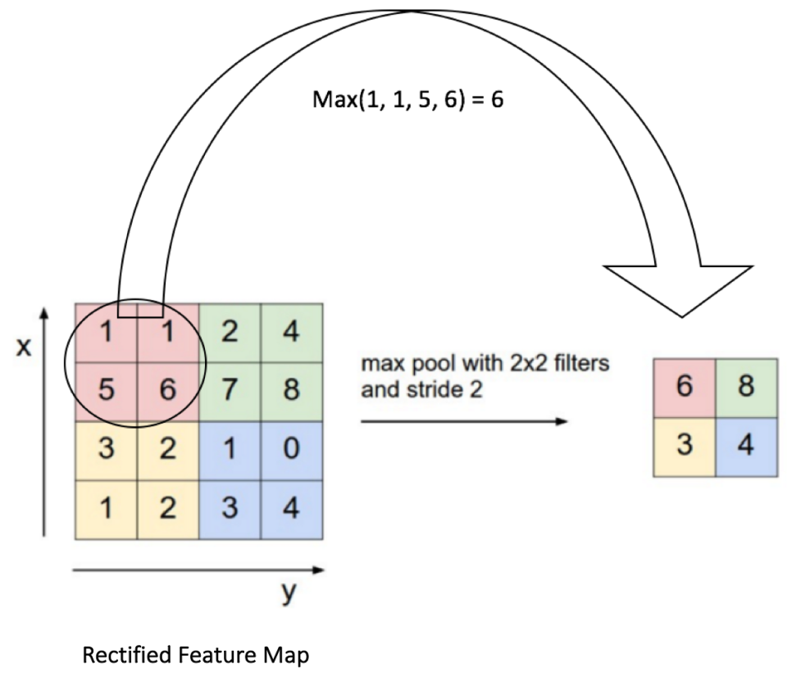
2) Pooling Layer
To reduce dimensionality of each feature map.
=> reduce # of parameters, computations & avoid overfitting.
Max pool vs. average pool.
invariant to small transformations, distortions, and translations in the input

Slide 23
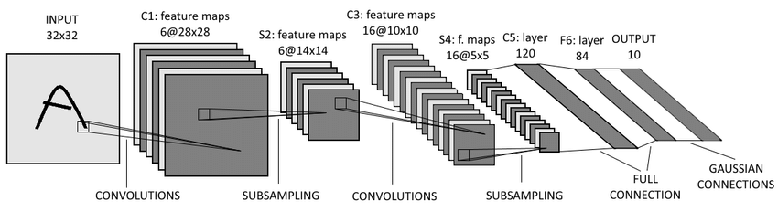
Discussion of some CNN architecture
LeNet

Slide 24

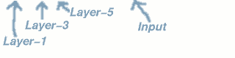
LeNet results

Slide 25
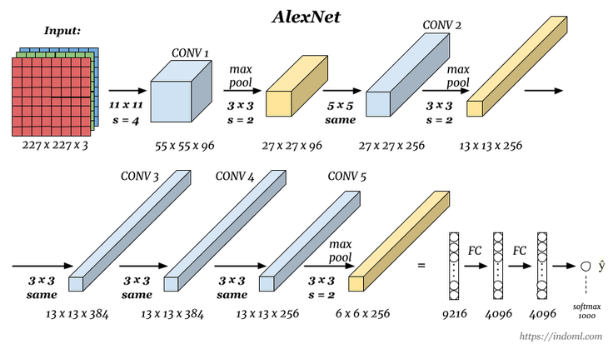
AlexNet - 2012

Slide 26
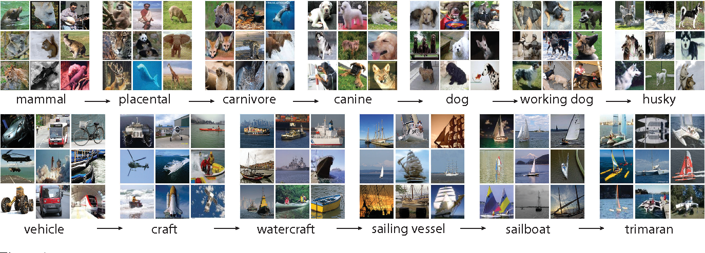
AlexNet results
Winner of the first ILSVRC-2012 competition (ImageNet Large Scale Visual Recognition Challenge).
Pioneering “deep” CNN with 84.6% accuracy, while the second-place model only achieved 73.8% accuracy rate.

Slide 27

VGG Net - 2014
https://arxiv.org/pdf/1409.1556.pdf

Slide 28
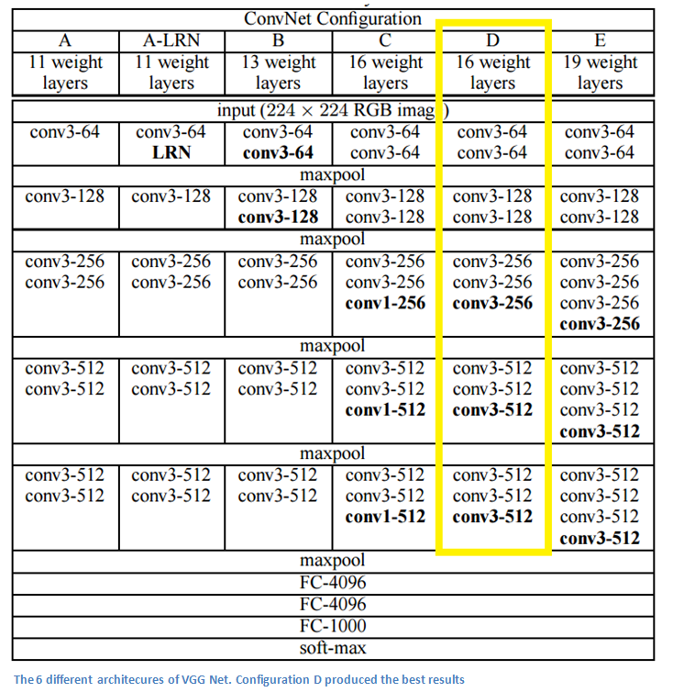
Varients
6 different configurations for
vgg net. The VGG16 produced
the best result.

Slide 29
VGG Net results
1st runner-up of ILSVRC ( ImageNet Large Scale Visual Recognition Competition) 2014 (Not the winner, winner was GoogleNet)
The first model reached a error rate below 10% (approx 7% on final model)
Very beauty and straightforward design

Slide 30
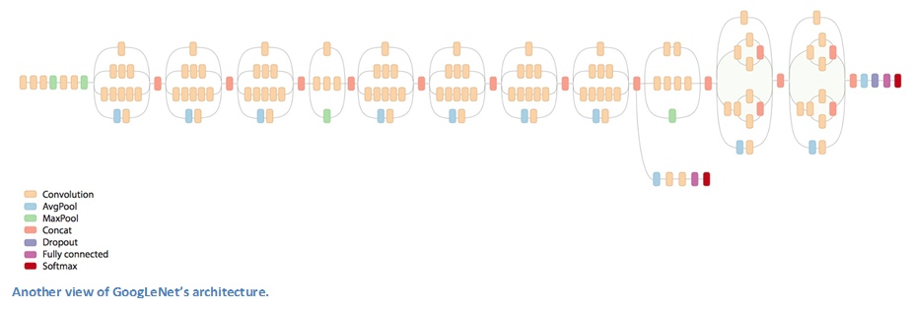
Inception Net - 2014

Slide 31
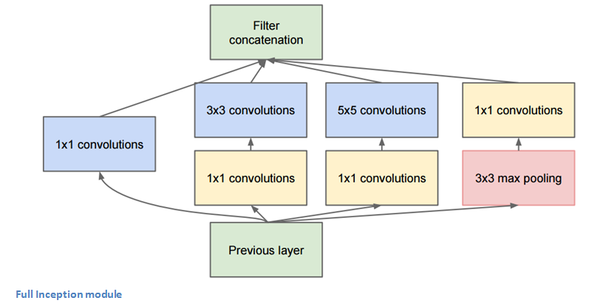
Inception Module

Slide 32
Inception Net results
Winner of ILSVRC 2014 with error rate of 6.7%
The first model didn’t follow the “conv-pool” stacking rule.
Doing pooling and conv with different filter size simutaneously
Uses 12x fewer parameters than AlexNet

Slide 33
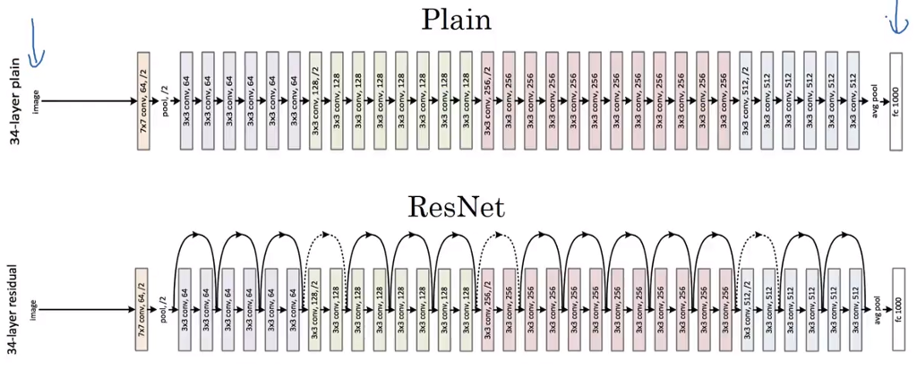
Microsoft Resnet - 2015
https://arxiv.org/pdf/1512.03385.pdf

Slide 34
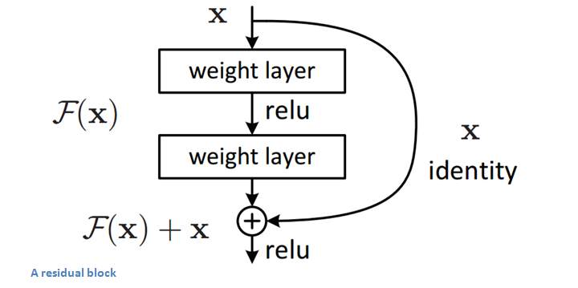
Resnet - Residual block

Slide 35
Resnet results
New records in # of layers : 152 layers
ResNet won ILSVRC 2015 with an error rate of 3.6%

Slide 36
Applications
Object Detection
Object tracking
Object Recognition
Semantic and Segmentation
Video Image Captioning
Notes:
CNN architectures continue to feature prominently in Computer Vision, with architectural advancements providing improvements in speed, accuracy, and training for many of the applications and tasks mentioned below:

Slide 37
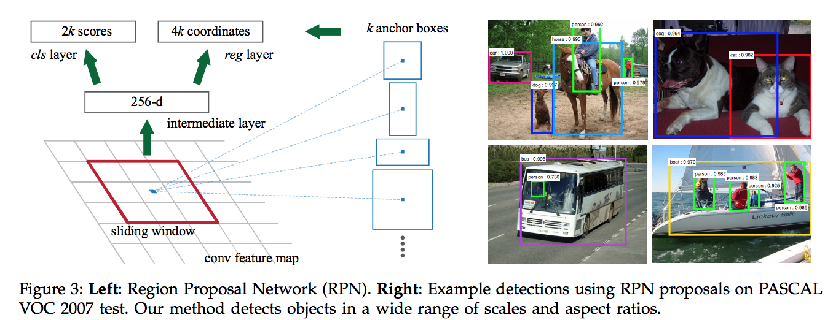
Object Detection
R-CNN, Fast R-CNN, Faster R-CNN
Notes:
In Object Detection, CNN is the major architecture behind the most popular models, such as: R-CNN, Fast R-CNN, Faster R-CNN. In these models, the net hypothesize object regions and then classifies them, using the CNN on top each of these region proposals. This is now the predominant pipeline for many object detection models, deployed in autonomous vehicles, smart video surveillance, facial detection, etc.

Slide 38
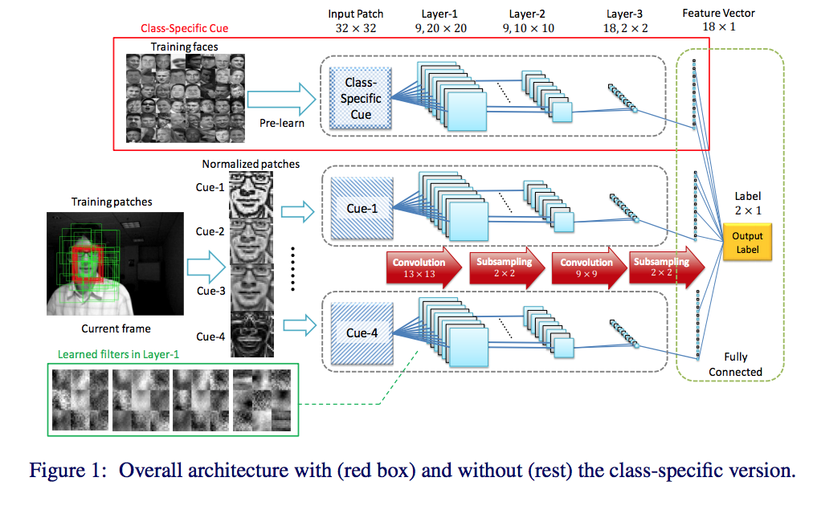
Object Tracking
DeepTrack
Notes:
In Object Tracking, CNNs have been used extensively in visual tracking applications. For example, given a CNN pre-trained on a large-scale image repository offline, this online visual tracking algorithm developed by the team at Pohang Institute in Korea can learn discriminative saliency maps to visualize a target spatially and locally. Another instance is DeepTrack, a solution to automatically relearn the most useful feature representations during the tracking process in order to accurately adapt appearance changes, pose, and scale variations while preventing drift and tracking failures.

Slide 39
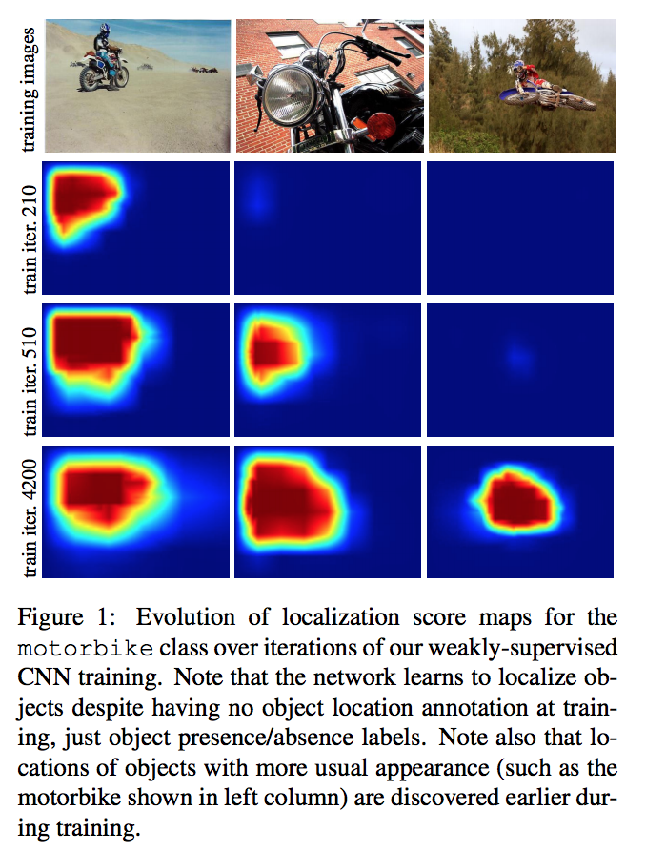
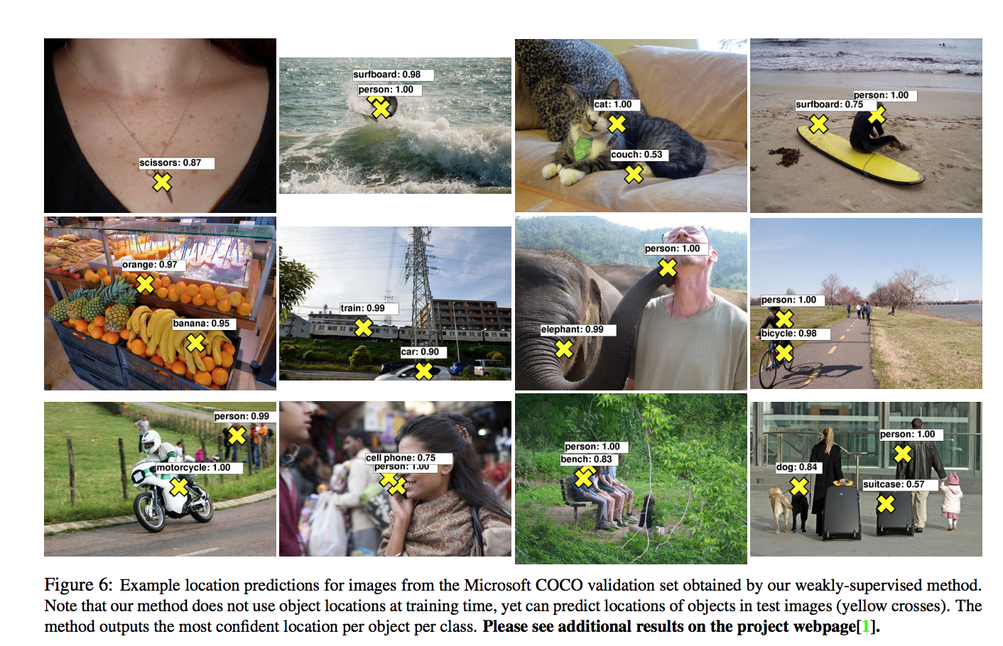
Object Recognition
Notes:
In Object Recognition, the team from INRIA and MSR in France developed a weakly supervised CNN for object classification that relies only on image-lvil labels, yet can learn from cluttered scenes containing multiple objects. Another instance is FV-CNN, a texture descriptor developed by people from Oxford to solve the clutter problem in texture recognition.[

Slide 40
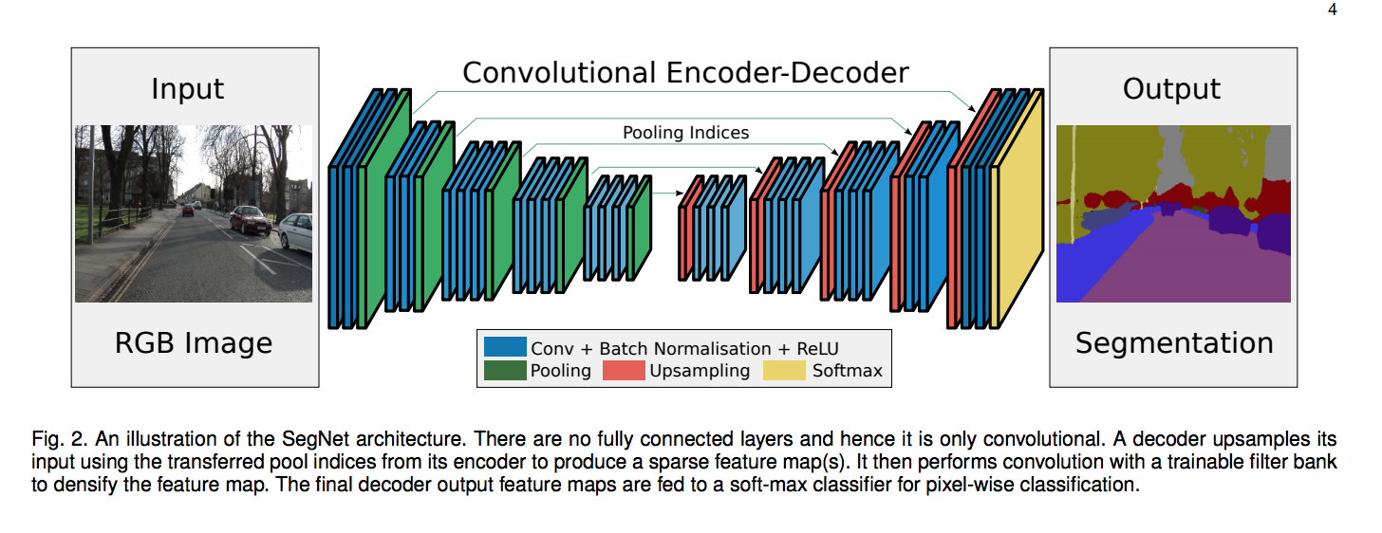
Semantic Segmentation
Notes:
In Semantic Segmentation, Deep Parsing Network is a CNN-based net developed by a group of researchers from Hong Kong to incorporate rich information into an image segmentation process. UC Berkeley’s researchers, on the other hand, built fully-convolutional networks and exceeded state-of-the-art semantic segmentation. Recently, SegNet is a deep fully convolutional neural network that is extremely efficient in terms of memory and computational time for semantic pixel-wise segmentation.

Slide 41
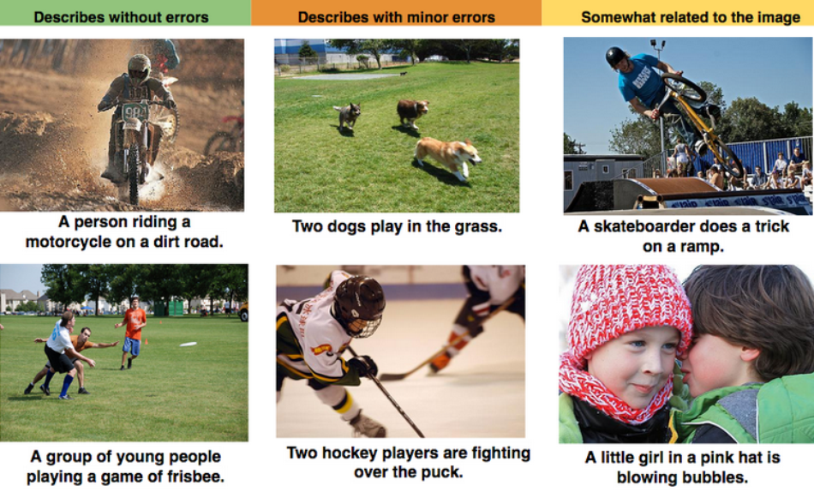
Video Image Captioning
Notes:
In Video and Image Captioning, the most important invention has been UC Berkeley’s Long-Term Recurrent Convolutional Nets, which incorporate both CNNs and RNNs (Recurrent Neural Nets) to tackle large-scale visual understanding tasks including activity recognition, image captioning, and video descriptions. It has been deployed heavily by the Data Science team at YouTube to make sense of the huge amount of videos uploaded to the platform daily.

